Slide 1

FOOD,WINE AND PREP!

Slide 2

WHAT IS SPOONACULAR ??
THE FOOD API

Slide 3
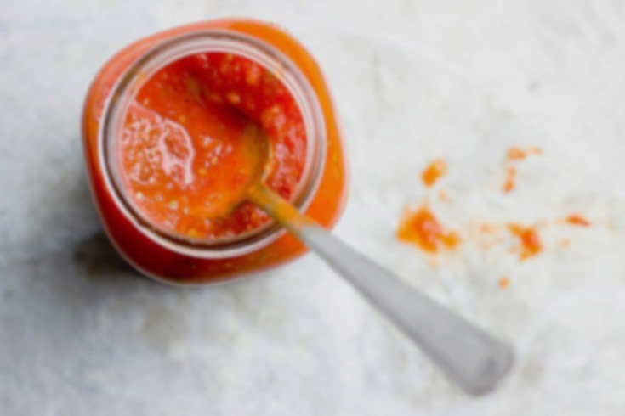
The Narrative
What the end-user will experience
Leave an impression
Explore the options
Customization of meals
Valuing end-users time

Slide 4
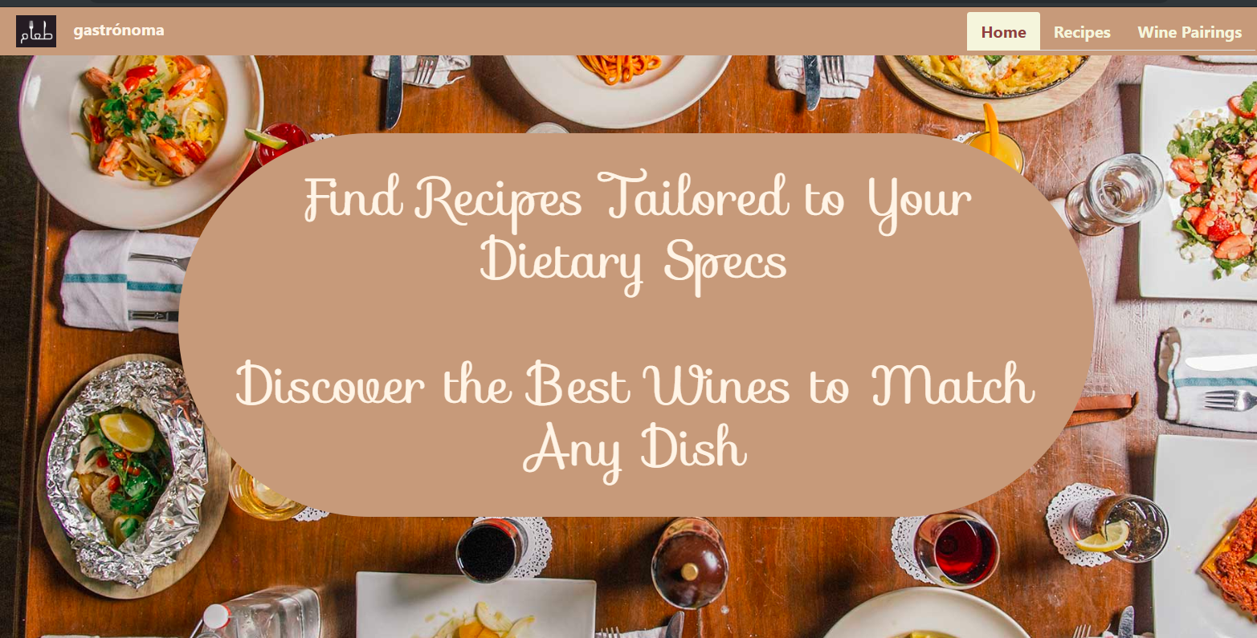
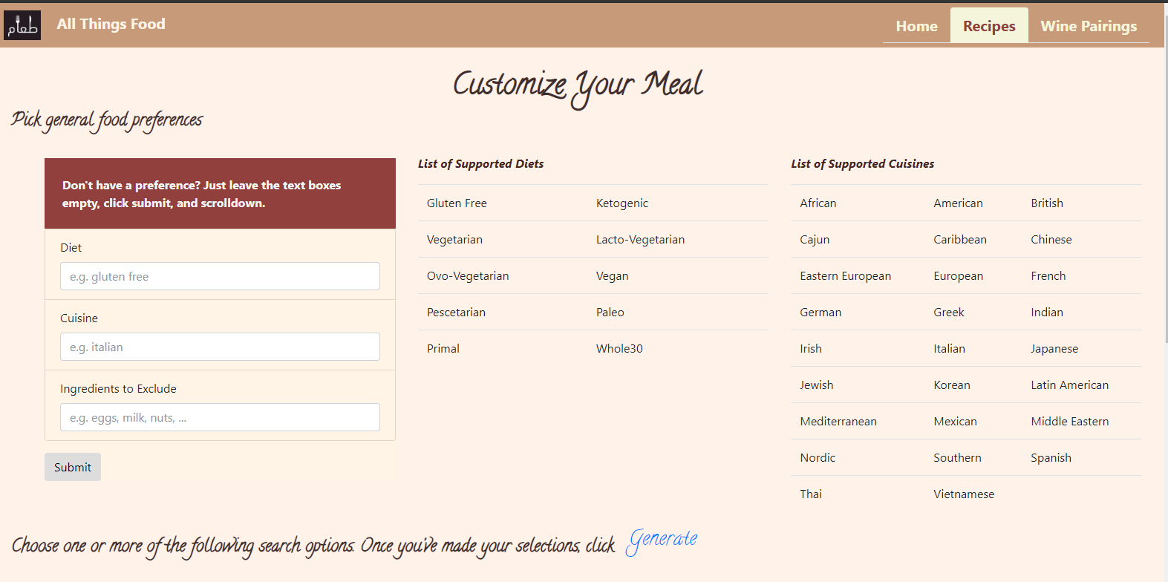
The webpage
outline

Slide 5
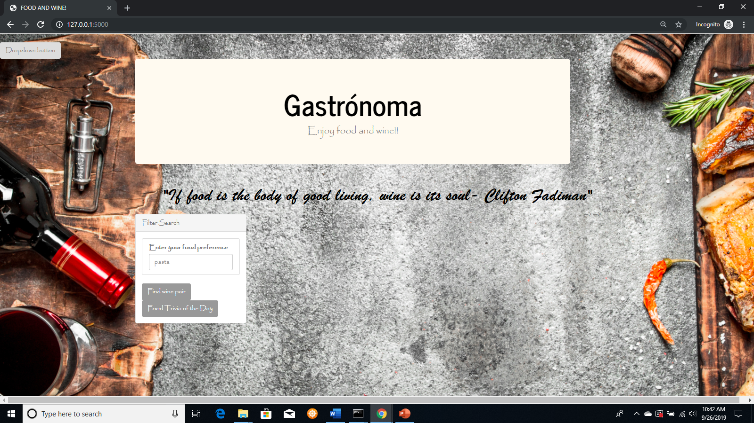
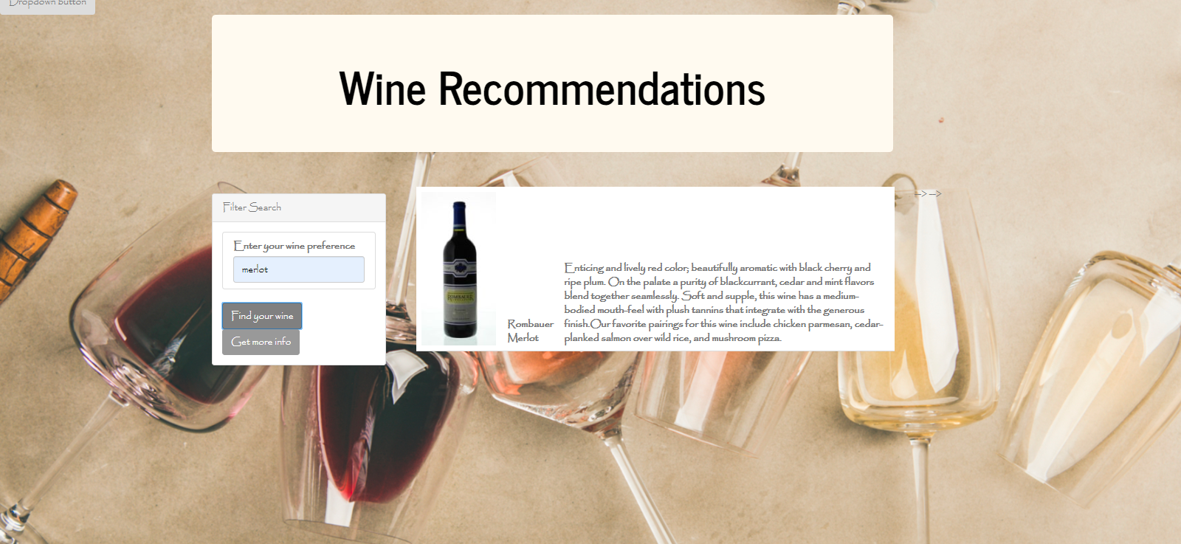
Subpages

Slide 6
Demonstration
The experience

Slide 7
Technical Challenges
Handling multiple form inputs
Sharing variables between webpages
Passing variables from Flask to App.js
“No Results Founds”
Clearing out HTML tables
API Calls and cost
Integration of Pages

Slide 8
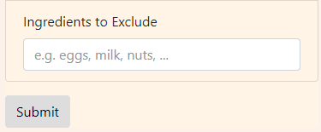
Handling Multiple Form Inputs
Multiple Forms
HTML
<form action="http://localhost:5000/selection" method="POST">
Some code here defining panel-body and list items…
<button name="btn-identifier“ value="general-btn"
class="btn btn-default“ id="general-btn"
type="submit“ >Submit</button>
</form>
Single Form
HTML
<form action="http://localhost:5000/selection" method="POST">
Some code here defining panel-body and list items…
<button class="btn btn-default“ id="general-btn"
type="submit">Submit</button>
</form>
Python-Flask
@app.route('/selection', methods=['POST', 'GET'])
def selection():
user_input = request.form
if user_input['btn-identifier'] == 'general-btn':
Process input from form 1…
elif user_input['btn-identifier'] == 'macros-btn':
Process input from form 2… return redirect('', 204)
Python-Flask
@app.route('/selection', methods=['POST', 'GET'])
def selection():
user_input = request.form
Some code to process user_input…
return redirect('', 204)

Slide 9
Sharing Variables b/w Multiple Webpages
Use a Flask session object
One method of storing user-specific data between different requests
Analogous to a global variable
Works just like a python dictionary
from flask_session import Session
app = Flask(__name__)
SESSION_TYPE = 'filesystem'
app.config.from_object(__name__)
Session(app)
Selection Route
@app.route('/selection', methods=['POST', 'GET'])
def selection():
user_input = request.form
if user_input['btn-identifier'] == 'general-btn':
session['general'] = user_input
elif user_input['btn-identifier'] == 'macros-btn':
session key = ‘macros’, and value = user_input
elif user_input['btn-identifier'] == 'ingredients-btn':
session key = ‘ingredients’, and value = user_input
elif user_input['btn-identifier'] == 'description-btn':
session key = ‘description’, and value = user_input return redirect('', 204)
Results Route
@app.route('/results')
def results():
selection_criteria = {}
for key, value in session.items():
selection_criteria[key] = value
session.clear()
recipes_info = get_recipe_info(selection_criteria)
return something

Slide 10
Passing Variable from Flask to APP.JS
Flask HTML APP.JS
Pass variable from Flask to HTML in render template
“Declare and Initialize” variable in HTML page
Pull variable in app.js from HTML page
Python-Flask
return render_template("results.html", recipe_result=recipes_info)
HTML
<div id="myRecipes" data-recipe='{{ recipe_result | tojson }}'></div>
JS
var myRecipes = JSON.parse(document.getElementById("myRecipes").dataset.recipe);

Slide 11
“No Results Found”
HTML + Flask
Create a simple webpage informing user that no results were found
Build a Flask route (‘/error’) to render the error page
Implement an error check in the results route
Results Route
@app.route('/results')
def results():
Get list of recipes
if list is empty:
return redirect(url_for('error'))
else:
return render_template("results.html", recipe_result=recipes_info)

Slide 12
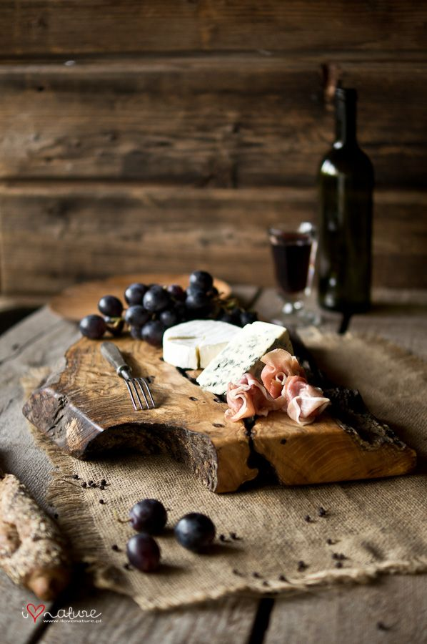
The importance of this App
Cut down on time for end-user
Customize unique meal plans with nutrition info
Get the end-user to explore wine and food combo

Slide 13
Conclusion
D3 and force functions
Troubleshooting connection to HTML from app routes
The complexity of integrating all applications
Quicker retrieval of recipes
Allowing user profiles

